Slide 1




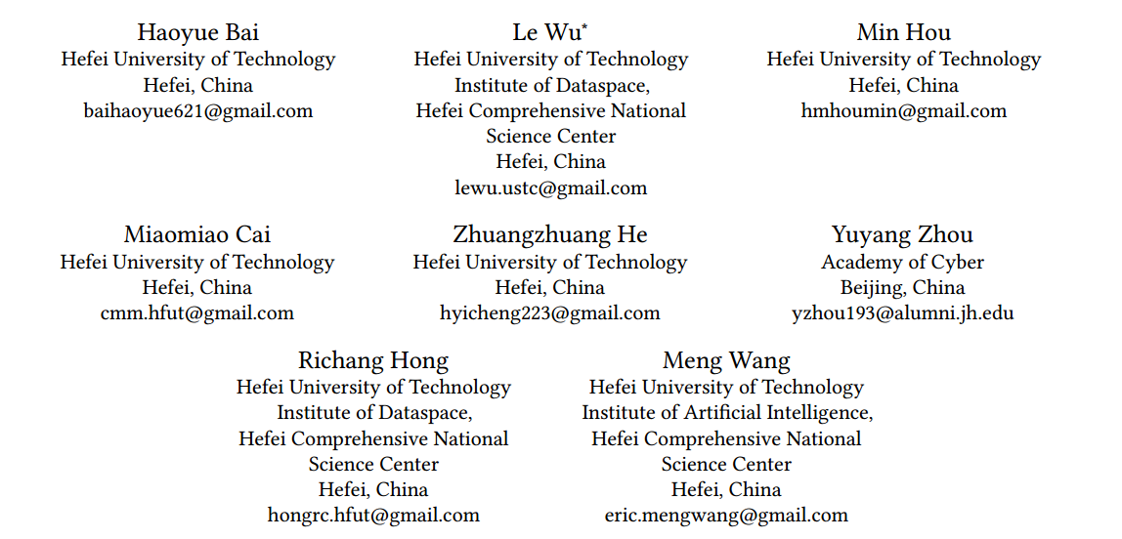



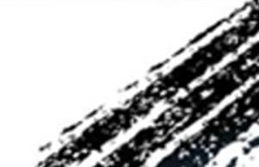

ATAI
Advanced Techniqueof Artificial Intelligence
ATAI
ChongqingUniversity _{AdvancedTechniqueof}
of Technology Artificial Intelligence
Chongqing University of
Technology
Chongqing University ^{ATAI}
_{of Technology} Advanced Techniqueof
Artificial Intelligence
Chongqing University of Technology
Chongqing University of Technology
Multimodality Invariant Learning for
Multimedia-Based New Item Recommendation
—— SIGIR 2024
Code:https://github.com/HaoyueBai98/MILK
Reported by Jing Li
1

Slide 2

ATAI
AdvancedTechniqueof
Artificial Intelligence
ATAI
ChongqingUniversity _{AdvancedTechniqueof}
of Technology Artificial Intelligence
ChongqingUniversity of Technology
Motivation
(1) Real-world items exhibit varying degrees of modality missingness. Nearly all previous works relied on modality completeness for recommendation or simply tackled this issue with preprocessing techniques to impute missing modalities.
(2) With the proliferation of digital devices and APPs, a huge number of new items are created rapidly over times. When faced with new items, most models need to be retrained on new items, which could not satisfy the quick adaption to new items at the inference stage. How to quickly provide recommendations for new items at the inference time is challenging
Notes:
在多模态学习场景中，某些模态比其他模态更占主导地位，因此模型将优化这些主导模态，并倾向于忽略其他模态，从而导致次优性能信息量较少的模态的优化不足，从而导致次优融合性能，因此出现了被称为模态惰性的现象。
多模态数据经常不相互纠缠或数据规模不同，导致整合困难。现实中采集的数据可能存在关键模态缺失的问题。
目前很多方法用的都是对所有模态进行联合优化（同时对所有模态的数据进行训练，使用一个整体的损失函数来联合优化各个模态的参数）
导致模态间干扰，产生模态惰性问题。
同时处理多模态数据，计算和存储需求较高，对数据的要求高。

Slide 3

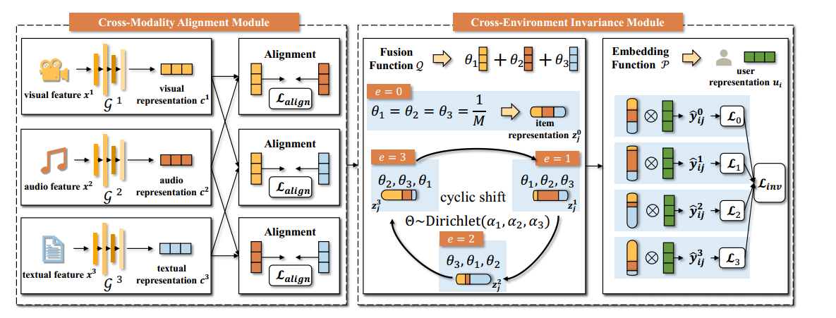
ChongqingUniversity of Technology
ATAI
AdvancedTechniqueof
Artificial Intelligence
ATAI
ChongqingUniversity _{AdvancedTechniqueof}
of Technology Artificial Intelligence
Overview
Notes:
实现交替单模态学习，每个时间步t确定当前输入的模态mt，确保每个模态都能独立进行优化，避免模态惰性问题。
计算对应模态的数据损失
使用梯度下降更新模态特定的参数
计算梯度修改矩阵
更新共享参数
计算每个模态的预测不确定性
确定模态重要性系数
组合所有模态的预测得到预测值

Slide 4

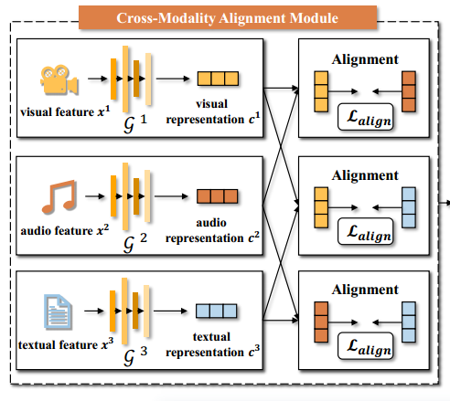





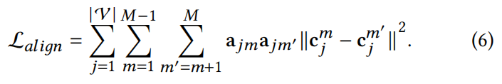
ChongqingUniversity of Technology
ATAI
AdvancedTechniqueof
Artificial Intelligence
ATAI
ChongqingUniversity _{AdvancedTechniqueof}
of Technology Artificial Intelligence
Method

Slide 5
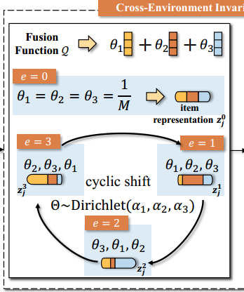
ChongqingUniversity of Technology
ATAI
AdvancedTechniqueof
Artificial Intelligence
ATAI
ChongqingUniversity _{AdvancedTechniqueof}
of Technology Artificial Intelligence
Method

Slide 6

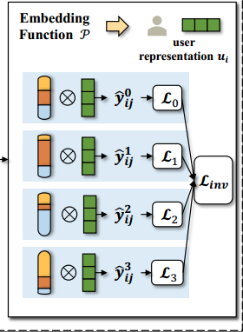
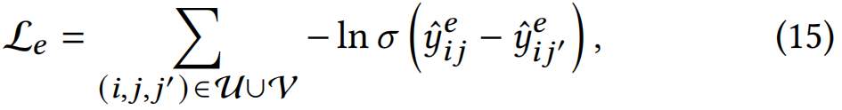
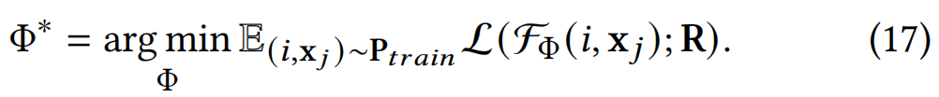
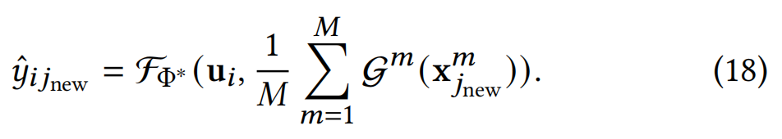
ChongqingUniversity of Technology
ATAI
AdvancedTechniqueof
Artificial Intelligence
ATAI
ChongqingUniversity _{AdvancedTechniqueof}
of Technology Artificial Intelligence
Method

Slide 7

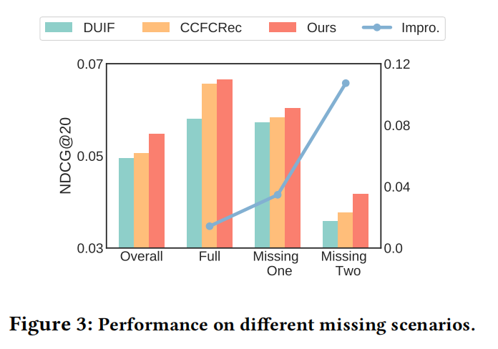
ATAI
AdvancedTechniqueof
Artificial Intelligence
ATAI
ChongqingUniversity _{AdvancedTechniqueof}
of Technology Artificial Intelligence
ChongqingUniversity of Technology
Experiments

Slide 8
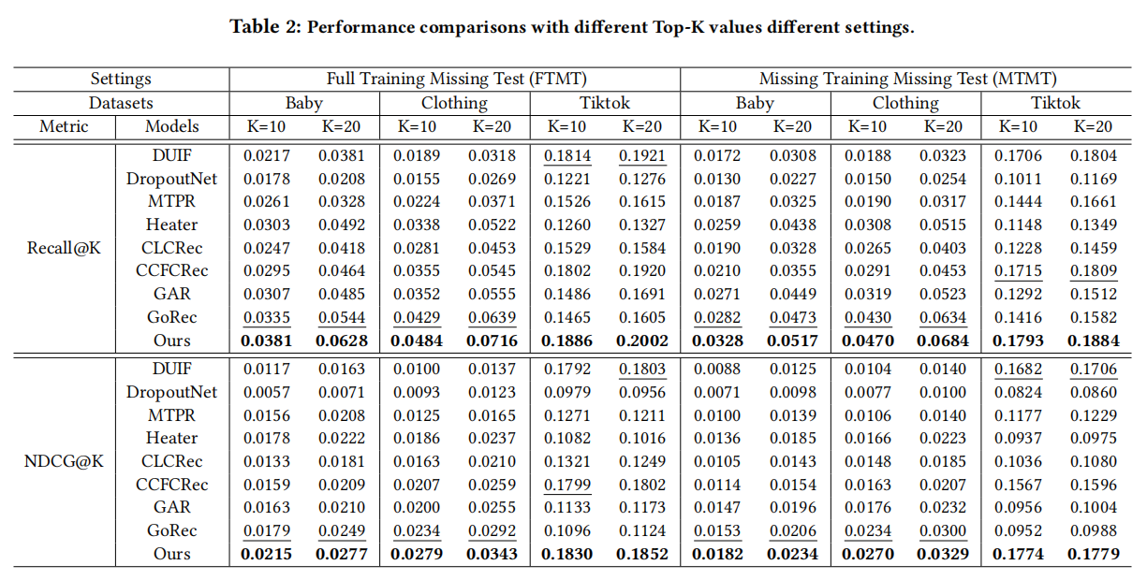
ATAI
AdvancedTechniqueof
Artificial Intelligence
ATAI
ChongqingUniversity _{AdvancedTechniqueof}
of Technology Artificial Intelligence
ChongqingUniversity of Technology
Experiments

Slide 9
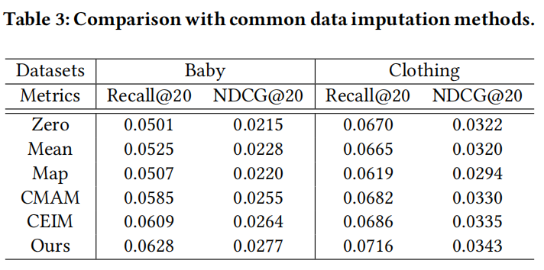
ATAI
AdvancedTechniqueof
Artificial Intelligence
ATAI
ChongqingUniversity _{AdvancedTechniqueof}
of Technology Artificial Intelligence
ChongqingUniversity of Technology
Experiments

Slide 10
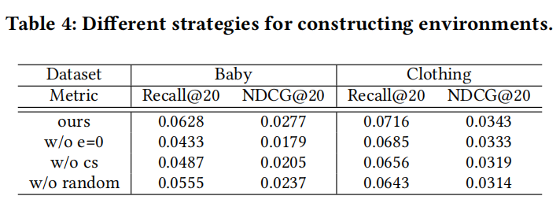
ATAI
AdvancedTechniqueof
Artificial Intelligence
ATAI
ChongqingUniversity _{AdvancedTechniqueof}
of Technology Artificial Intelligence
ChongqingUniversity of Technology
Experiments

Slide 11
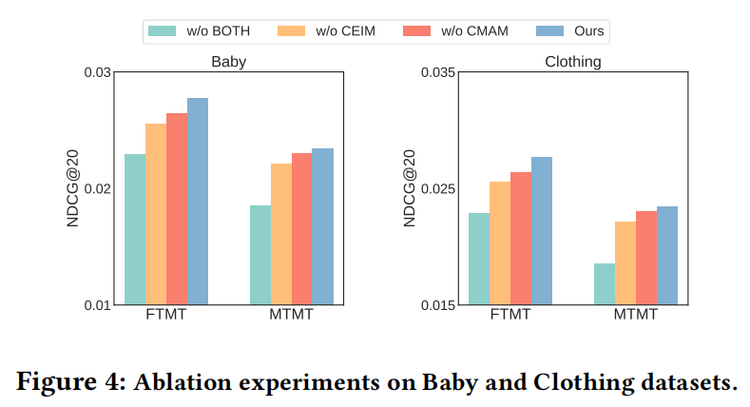
ATAI
AdvancedTechniqueof
Artificial Intelligence
ATAI
ChongqingUniversity _{AdvancedTechniqueof}
of Technology Artificial Intelligence
ChongqingUniversity of Technology
Experiments

Slide 12
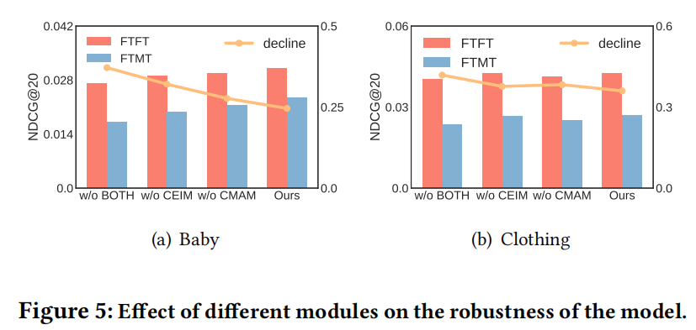
ATAI
AdvancedTechniqueof
Artificial Intelligence
ATAI
ChongqingUniversity _{AdvancedTechniqueof}
of Technology Artificial Intelligence
ChongqingUniversity of Technology
Experiments

Slide 13


ChongqingUniversity of Technology
ATAI
AdvancedTechniqueof
Artificial Intelligence
ATAI
ChongqingUniversity _{AdvancedTechniqueof}
of Technology Artificial Intelligence
Thanks!

